Slide 1


BANK LOAN OF
CUSTOMERS
(P-597) BY GROUP - 2

Slide 2

PRESENTED BY :
Fathima Ansiya. K
Prachi Saraf
Kishan Kabadi
Hazari Indraraj Gupta
Asila Zaib
Subhankar Mohanty MENTOR : NANDHANA.R

Slide 3

INTRODUCTION OBJECTIVES & IMPORTANCE TOOLS & THEIR ROLES PROJECT METHODOLOGY KPI’S KPI OBSERVATION EXCEL DASHBOARD POWER BI DASHBOARD TABLEAU DASHBOARD SQL QUERIES
INSIGHTS&SUGGESTIONS
CHALLENGES & SOLUTIONS
CONCLUSION
AGENDA

Slide 4

INTRODUCTION
Welcome to our presentation on the "Bank Loan Analysis of Customers”. In today's financial landscape, banks play a crucial role in providing loans to individuals and businesses. Understanding customer behavior and predicting their loan repayment capabilities are vital for minimizing risk and maximizing profitability. In this project, we analyze various customer attributes and their impact on loan approval decision. Our analysis focuses on several key factors, including income levels, credit history, and other demographic information, to identify patterns and trends. Ultimately, this project aims to support banks in optimizing their loan portfolios and enhancing financial stability.

Slide 5
.
.
Objectives
Importance
The bank analysis project plays a vital role in enhancing the overall performance and strategic direction. By leveraging data driven insights , the project supports informed decision-making, effective risk management, and targeted customer service. It also identifies opportunities for operational efficiency and market expansion, providing a competitive edge. Ultimately, the project contributes to revenue growth, cost reduction, and long-term success, making it a cornerstone of the bank's strategic initiatives.
Analyze Customer Profiles: To examine various customer attributes such as income, employment status, credit history, and demographics to understand their impact on loan approval and repayment behavior.
Identify Key Risk Factors: To identify the key factors that contribute to loan defaults and late repayments, enabling the bank to better manage and mitigate credit risk.
Develop Predictive Models: To build predictive models that forecast loan approval outcomes based on customer data, improving the accuracy and efficiency of the bank's lending decisions.
Optimize Loan Approval Processes: To streamline the loan approval process by using data-driven insights, reducing time and costs associated with manual assessments.
By achieving these objectives, the project aims to help banks improve their lending strategies reduce risk and maximize profitability.

Slide 6
EXTRACT DATA
TRANSFORMATION
MERGING, LOADING & USING TOOLS
KPIs CREATION & VISUALIZATION
DASHBOARD ANALYSIS USING DIFFERENT MODULES
PROJECT METHODOLOGY

Slide 7
PROJECT ANALYSIS
1. Data Challenges:
Data Storage:
Data spread across multiple platforms (SQL, Excel, CSV).
Insufficient data structuring and normalization.
Lack of Comprehensive Insights:
Disconnected datasets leading to fragmented analysis.
Difficulty in making informed business decisions due to scattered data.
2. Data Solutions:
Data Integration:
Centralized data collection and storage.
Data normalization across SQL, Excel, and CSV for consistency.
ETL Process Optimization:
Cleaned and standardized data using Excel and SQL.
Reduced data redundancy and improved storage efficiency.
3. Analytical Insights:
Dashboard Creation:
Developed interactive dashboards using Tableau and Power BI.
Enabled real-time monitoring of key metrics and KPIs.
Enhanced Decision-Making:
Provided actionable insights to improve loan strategies and customer targeting.
4.Outcome:
Improved Data Utilization : Optimized data storage and access across the bank’s analytics tools.
Efficient Analysis: Streamlined data processes led to quicker, more accurate insights.

Slide 8





TOOLS USED AND THEIR ROLES
Excel played a foundational role in the project, particularly in the initial stages of data exploration and analysis. Its versatility and widespread use made it an ideal tool for handling smaller datasets and performing preliminary analysis.
Power BI was a key tool in this project for advanced data visualization, providing a dynamic and interactive platform for analyzing the bank’s loan data. The primary goal was to create comprehensive visual representations of key metrics and trends, enabling stakeholders to make informed decisions quickly.
Tableau was another critical tool used in the project, primarily for its advanced data visualization capabilities and user-friendly interface. It was particularly effective in presenting a broad overview of the bank's loan portfolio and customer demographics.
SQL was the backbone of the data extraction and manipulation process in this project. It was used to query the bank’s databases, retrieve relevant data, and perform complex data transformations that laid the foundation for subsequent analysis in Excel, Tableau, and Power BI.

Slide 9





KEY PERFOMANCE INDICATORS
2.GRADE & SUBGRADE WISE REVOL_BALANCE
1.YEAR WISE LOAN
AMOUNT STATUS
3.TOTAL PAYMENT FOR VERIFIED & NONVERIFIED STATUS
4.STATE WISE MONTH WISE LOAN_STATUS
5.HOMEOWNERSHIP V/S LAST PAYMENT DATE STATUS

Slide 10
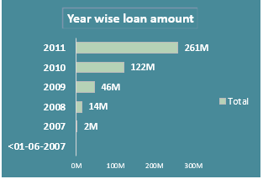
KPI’S OBSERVATIONS
1.Year-wise Loan Amount Stats:
Observation: The loan amounts issued over the years display significant fluctuations, with a notable peak in 2008, followed by a substantial decline in subsequent years.
Result: The peak in 2008 may be attributed to the economic conditions or specific bank policies at that time, while the decline suggests a possible impact of the 2008 financial crisis, leading to more conservative loan approvals in subsequent years.
.

Slide 11
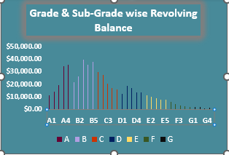
2.Grade and Sub-Grade wise Revolving Balance:
Observation: Higher grades (A and B) generally correspond to higher revolving balances, with a noticeable concentration of balances in the mid-to-lower sub-grades (B3, B4, C3, etc.).
Result: Customers with better credit grades are likely to carry higher balances, indicating trust from the bank. However, the concentration in specific sub-grades suggests a potential risk area that may require closer monitoring.

Slide 12
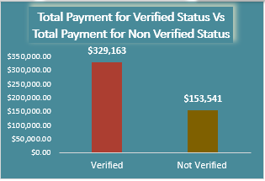
3.Total Payment for Verified Status vs. Non-Verified Status:
Observation: A larger portion of the total payments comes from verified loans, which indicates that loans with verified statuses are more likely to follow through with consistent payments.
Result: Verification processes play a crucial role in ensuring loan repayment, with verified loans showing significantly better payment performance than non-verified ones

Slide 13
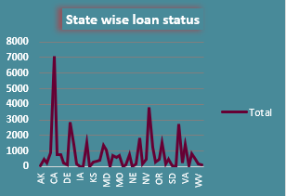
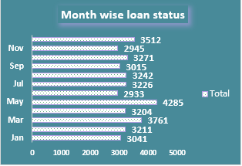
4.State-wise and Month-wise Loan Status:
Observation: Certain states have higher loan issuance rates, with fluctuations observed on a month-to-month basis. For example, states like California and Texas may show higher loan volumes.
Result: Geographic concentration of loans might be influenced by the population size, economic activity, or targeted marketing efforts in those states. Seasonal trends may also impact monthly loan issuance, requiring adjusted strategies in low-activity periods.

Slide 14
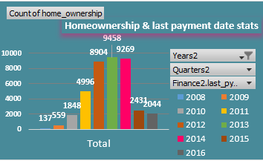
5.Home Ownership vs. Last Payment Date Stats:
Observation: Homeownership status (Own, Rent, Mortgage) correlates with the timeliness of the last payment date. For instance, homeowners might show better payment consistency compared to renters.
Result: Customers who own homes or have mortgages are generally more reliable in terms of making timely payments, which could be factored into the risk assessment and loan approval process.

Slide 15
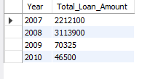
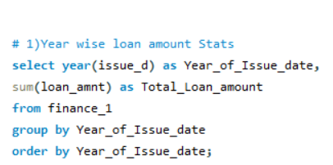
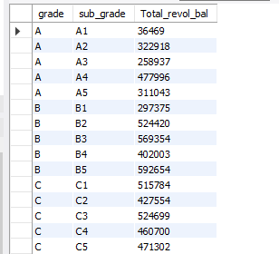
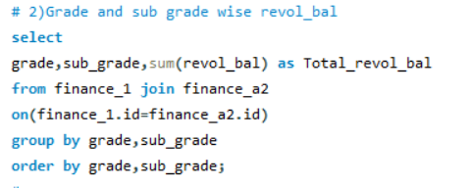
Year wise Loan Amount Status
OUTPUT
Grade and Subgrade wise revol_bal
OUTPUT

Slide 16
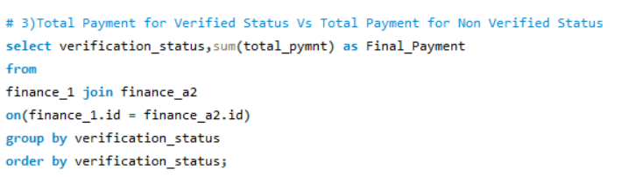
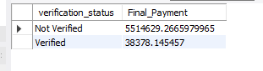
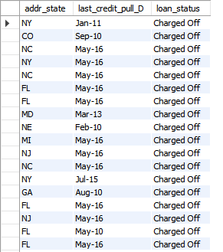
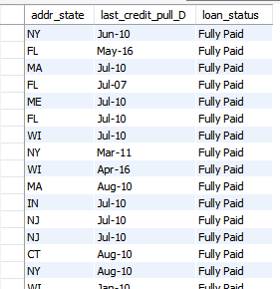
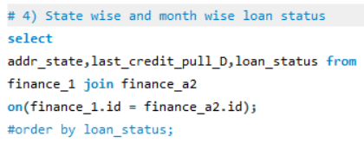
Total Payment for Verified & Non Verified Status
OUTPUT
State wise and Month wise loan status
OUTPUT

Slide 17
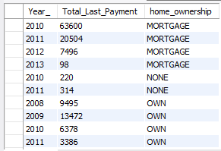
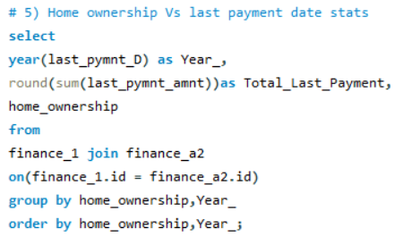
Home Ownership Vs Last payment date status
OUTPUT

Slide 18
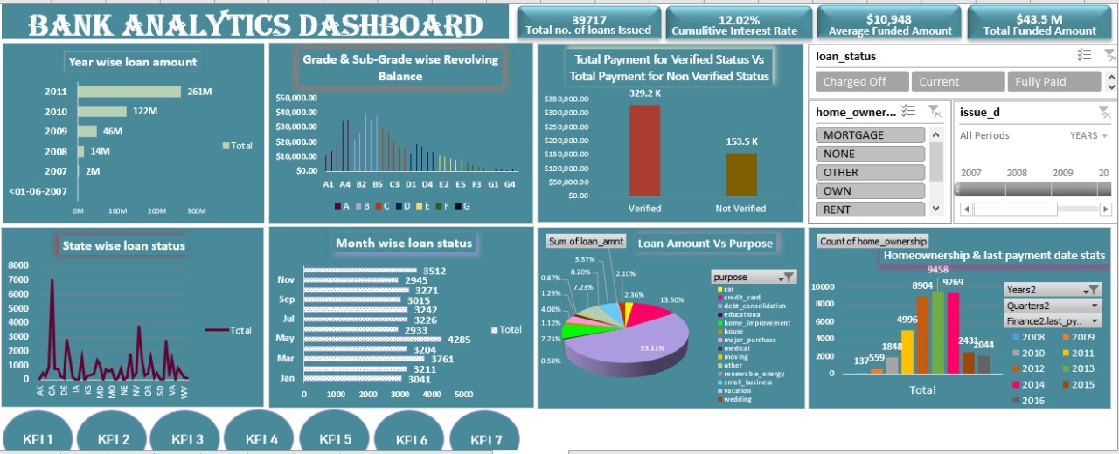
EXCEL DASHBOARD

Slide 19
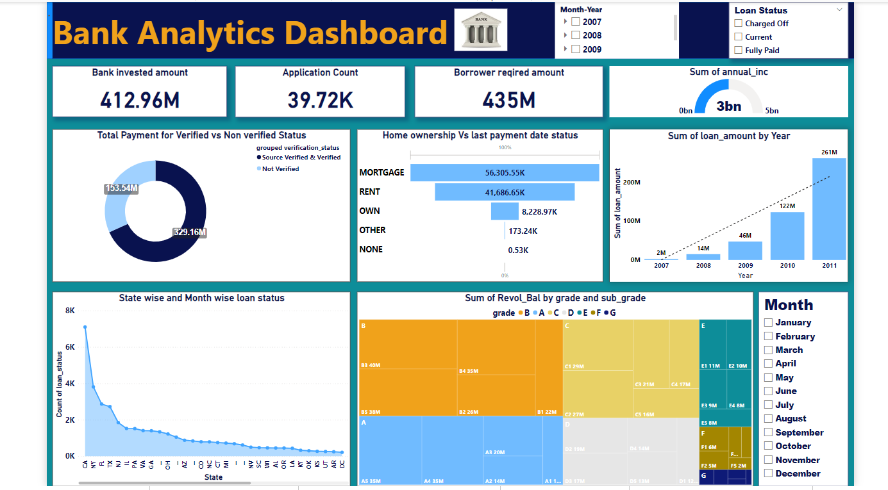
POWER BI DASHBOARD

Slide 20
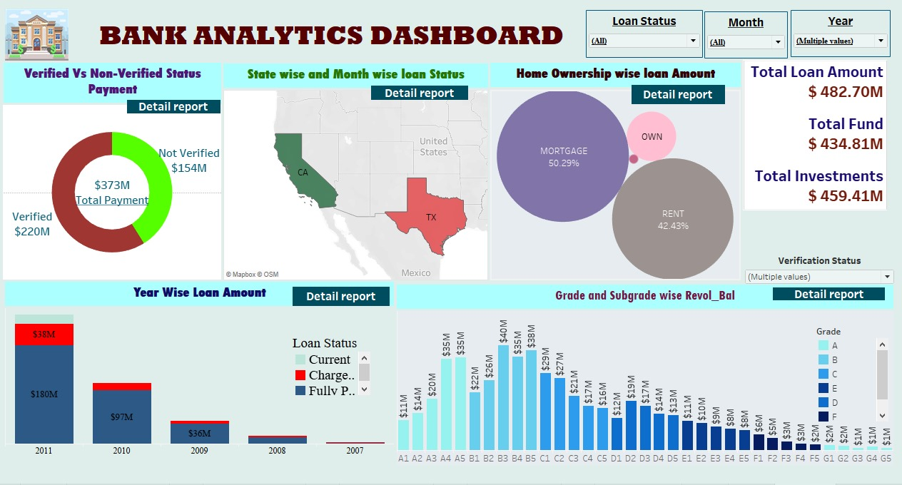
TABLEAU DASHBOARD
TABLEAU DASHBOARD

Slide 21
CHALLENGES & SOLUTIONS
1
Data Quality and Integrity
Challenge:
One of the primary challenges in this project was ensuring the quality and integrity of the data. The data came from various sources, including SQL databases, Excel files, and other internal systems. Inconsistent formats, missing values, and duplicate records posed significant obstacles during the initial stages of analysis.
Solution:
Data Cleaning: A rigorous data cleaning process was implemented using SQL and Excel. This involved removing duplicates, filling in or correcting missing values, and standardizing formats (e.g., date formats, currency values).
Data Validation: Data validation rules were established to ensure that all data entries met specific criteria before being included in the analysis. This helped in maintaining data integrity and reliability throughout the project.
Automation: Where possible, automation tools were employed to streamline the data cleaning process, reducing the likelihood of human error and speeding up the workflow.
2
Integration of Multiple Tools
Challenge:
The project required the integration of multiple tools—SQL for data extraction, Excel for preliminary analysis, Tableau for visualization, and Power BI for interactive dashboards. Ensuring seamless data flow between these tools while maintaining consistency was challenging.
Solution:
Data Export/Import Workflows: Clear workflows were established for exporting data from SQL, processing it in Excel, and importing it into Tableau and Power BI. This ensured that data remained consistent and that the tools worked together harmoniously.
Unified Data Model: A unified data model was created in Power BI, which allowed for consistent relationships and calculations across different datasets. This model served as a central repository for all the data used in the visualizations.
Cross-Tool Training: The team underwent cross-training on all tools involved, ensuring that everyone had a basic understanding of how data moved through each tool and how to troubleshoot issues that might arise during the integration process.

Slide 22
3
Handling Large Datasets
Challenge:
The volume of data was significant, which posed performance challenges, particularly when running complex queries in SQL or creating visualizations in Power BI and Tableau. Slow query execution and dashboard load times could hinder the analysis process.
Solution:
Data Aggregation: To manage large datasets, data was aggregated at higher levels where detailed granularity was not necessary. For example, loan data could be summarized by year or by state rather than by individual transaction, reducing the amount of data processed at once.
Indexing and Optimization: SQL queries were optimized by indexing key columns, reducing the time required to retrieve data. Additionally, complex queries were broken down into smaller, more manageable components.
Incremental Loading: In Power BI, incremental data loading was used, which updated only the new or changed data rather than reloading the entire dataset each time. This significantly improved performance.
4
Ensuring Accurate Insights
Challenge:
Ensuring that the insights derived from the data were accurate and reflective of real business scenarios was critical. Misinterpretations or errors in the analysis could lead to incorrect conclusions and poor decision-making.
Solution:
Collaborative Review: Regular collaborative sessions were held where data analysts, business experts, and stakeholders reviewed the findings together. This ensured that insights were aligned with business realities and that any anomalies were quickly identified and addressed.
Multiple Validation Layers: The analysis was validated at multiple layers—initially in SQL, then in Excel, and finally in the visualization tools. This multi-layered approach minimized the risk of errors and ensured the accuracy of the insights.
Sensitivity Analysis: Sensitivity analysis was performed on key metrics to understand how changes in assumptions or data could impact the results. This helped in identifying which insights were robust and which needed further scrutiny.

Slide 23
INSIGHTS & SUGGESTIONS
Loan Distribution by State:
Insight: The analysis revealed that certain states, such as California (CA), Florida (FL), and Texas (TX), have significantly higher loan amounts compared to others. These states account for a substantial portion of the bank’s total loan portfolio.
Suggestion: Focus on maintaining strong relationships in these key states while exploring opportunities to expand loan services in underrepresented states to diversify the loan portfolio and reduce geographic risk.
Loan Purpose Trends:
Insight: The majority of the loans were issued for mortgage purposes, accounting for over 50% of the total loan amount. This indicates a strong demand for home loans. However, there is also a noticeable segment of loans taken for rent and other personal purposes.
Suggestion: Given the dominance of mortgage loans, the bank should consider offering specialized mortgage products or incentives to attract more customers in this segment. Additionally, there could be opportunities to develop targeted loan products for the rent segment to cater to a different customer base.
Verification Status Impact:
Insight: A significant portion of the loan payments, approximately $154 million, are from loans that were not verified. This poses a higher risk for defaults and potential losses.
Suggestion: Implement stricter verification processes for loan approvals to reduce the risk associated with unverified loans. Additionally, consider re-evaluating existing unverified loans to mitigate potential risks.

Slide 24
4.Year-Over-Year Loan Performance:
Insight: The analysis showed a fluctuating trend in loan amounts issued each year, with a noticeable dip during certain periods (e.g., in 2009 and 2010). This could be attributed to economic factors such as the financial crisis.
Suggestion: The bank should perform a deeper analysis of external factors influencing loan demand to better predict future trends. Developing contingency plans for economic downturns could help stabilize loan issuance during volatile periods.
5.Customer Segmentation:
Insight: The loan data showed distinct differences in loan amounts across various customer segments, particularly when segmented by loan grades and sub-grades. Higher grades (e.g., A1, A2) tend to have larger loan amounts, while lower grades are more associated with smaller, riskier loans.
Suggestion: Focus on retaining high-grade customers by offering them preferential rates or benefits. For lower-grade customers, consider implementing more stringent credit checks or offering financial literacy programs to help them improve their creditworthiness.
6.Geographic Risk Concentration:
Insight: The geographic analysis identified certain areas with high concentrations of loans but also highlighted regions with elevated default rates. This suggests a concentration of risk in specific areas.
Suggestion: The bank should consider diversifying its loan portfolio by exploring new geographic markets or adjusting loan terms in high-risk areas. This can help mitigate the concentration of risk and enhance overall portfolio stability.

Slide 25
CONCLUSION
The Bank Analysis Project has provided valuable insights into the bank's loan portfolio, customer behavior, and operational efficiency. By utilizing tools such as Excel, SQL, Tableau, and Power BI, we conducted a comprehensive analysis that revealed key trends, identified potential risks, and highlighted opportunities for growth.
The project has shown that data-driven decision-making is essential for optimizing loan offerings, enhancing customer satisfaction, and managing financial risk. It has also underscored the importance of targeted strategies, such as focusing on high-grade customers and improving verification processes, to ensure long-term profitability.
Moreover, the insights gained from analyzing KPIs, such as year-wise loan amounts, grade-wise revolving balances, and state-wise loan statuses, have provided a clear understanding of the bank's current position and future potential. The project has also addressed challenges related to data quality and process inefficiencies, offering solutions that can be implemented to improve overall performance.
In conclusion, the Bank Analysis Project has laid the groundwork for more strategic, informed, and efficient operations. By continuing to leverage the findings and recommendations from this analysis, the bank is well-positioned to achieve its goals, mitigate risks, and maintain a competitive edge in the financial industry.

Slide 26

THANK YOU!

